Slide 1
Quick Review of Markov Decision Processes

Slide 2
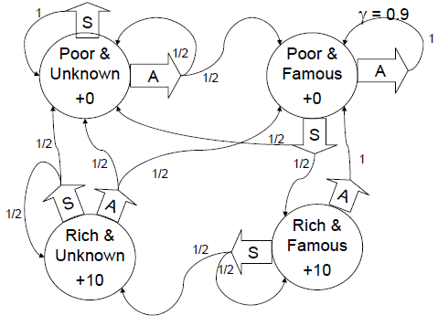
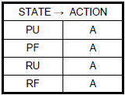
Example MDP
You run a startup company.
In every state you must choose between saving money and advertising.
v
v
v
Example policy
v

Slide 3
Assume
Initialize
i
1
2
3
4
5
6
$U\left(PU\right)U\left(PF\right)U\left(RU\right)U\left(RF\right)$

Slide 4
Assume
Initialize
i
1
2
3
4
5
6
$U\left(PU\right)U\left(PF\right)U\left(RU\right)U\left(RF\right)$
$U_{1}\left(RF\right)=10+0.9∗0$

Slide 5
Assume
Initialize
i
1 | 0 | 0 | 10 | 10
2
3
4
5
6
$U\left(PU\right)U\left(PF\right)U\left(RU\right)U\left(RF\right)$

Slide 6
Assume
Initialize
i
1 | 0 | 0 | 10 | 10
2 |  |  |  | 19
3
4
5
6
$U\left(PU\right)U\left(PF\right)U\left(RU\right)U\left(RF\right)$

Slide 7
Assume
Initialize
i
1 | 0 | 0 | 10 | 10
2 | 0 | 4.5 | 14.5 | 19
3
4
5
6
$U\left(PU\right)U\left(PF\right)U\left(RU\right)U\left(RF\right)$

Slide 8
Assume
Initialize
i
1 | 0 | 0 | 10 | 10
2 | 0 | 4.5 | 14.5 | 19
3 | 2.03 | 8.55 | 16.53 | 25.08
4 | 4.76 | 12.20 | 18.35 | 28.72
5 | 7.63 | 15.07 | 20.40 | 31.18
6 | 10.21 | 17.46 | 22.61 | 33.21
$U\left(PU\right)U\left(PF\right)U\left(RU\right)U\left(RF\right)$

Slide 9
Questions on MDPs?

Slide 10
Reinforcement learning

Slide 11
Reinforcement Learning (RL)
Imagine playing a new game whose rules you don’t know; after a hundred or so moves, your opponent announces, “You lose”.

Slide 12
Reinforcement Learning
Agent placed in an environment and must learn to behave optimally in it
Assume that the world behaves like an MDP, except:
Agent can act the transition model is unknown
Agent observes its current state and its reward, but the reward function is unknown
Goal: learn an optimal policy

Slide 13
Factors that Make RL Difficult
Actions have non‐deterministic effects
which are initially unknown and must be learned
Rewards / punishments can be infrequent
Often at the end of long sequences of actions
How do we determine what action(s) were really responsible for reward or punishment? (credit assignment problem)
World is large and complex

Slide 14
Passive vs. Active learning
Passive learning
The agent acts based on a fixed policy π and tries to learn how good the policy is by observing the world go by
Analogous to policy evaluation in policy iteration
Active learning
The agent attempts to find an optimal (or at least good) policy by exploring different actions in the world
Analogous to solving the underlying MDP

Slide 15
Model‐Based vs. Model‐Free RL
Model based approach to RL:
learn the MDP model ( and ), or an approximation of it
use it to find the optimal policy
Model free approach to RL:
derive the optimal policy without explicitly learning the model
We will consider both types of approaches

Slide 16
Passive Reinforcement Learning
Assume fully observable environment.
Passive learning:
Policy is fixed (behavior does not change).
The agent learns how good each state is.
Similar to policy evaluation, but:
Transition function and reward function are unknown.
Why is it useful?

Slide 17
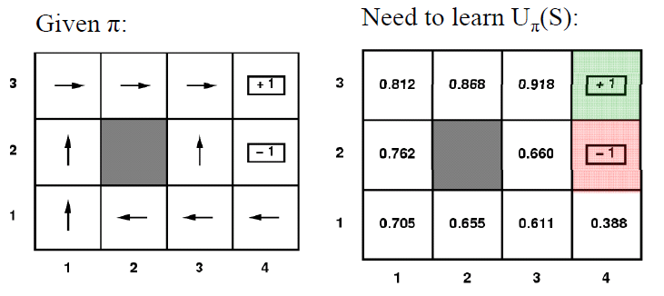
Passive RL
Suppose we are given a policy
Want to determine how good it is

Slide 18
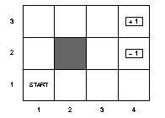
Passive RL
Follow the policy for many epochs (training sequences)

Slide 19
(model free)
Approach 1: Direct Utility Estimation
Direct utility estimation
Estimate as average total reward of epochs containing s (calculating from s to end of epoch)
Reward to go of a state
the sum of the (discounted) rewards from that state until a terminal state is reached
Key: use observed reward to go of the state as the direct evidence of the actual expected utility of that state

Slide 20
Approach 1: Direct Utility Estimation
Follow the policy for many epochs (training sequences)
For each state the agent ever visits:
For each time the agent visits the state:
Keep track of the accumulated rewards from the visit onwards.

Slide 21
Direct Utility Estimation
Example observed state sequence:
(assuming )

Slide 22
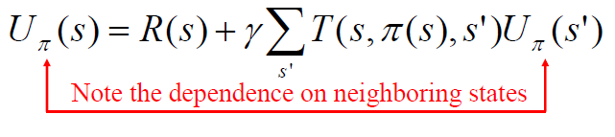
Direct Utility Estimation
As the number of trials goes to infinity, the sample average converges to the true utility
Weakness:
Converges very slowly!
Why?

Slide 23
Utilities of states are not independent!
P=0.9
-1
NEW
U = ?
OLD
U = -0.8
P=0.1
+1
An example where Direct Utility Estimation does poorly. A new state is reached for the first time, and then follows the path marked by the dashed lines, reaching a terminal state with reward +1. , even though for the neighboring node

Slide 24
(model based)
Approach 2: Adaptive Dynamic Programming
Learns transition probability function and reward function from observations.
Plugs values into Bellman equations.
Solves equations policy evaluation (or linear algebra)

Slide 25
Adaptive Dynamic Programming
Learning the reward function :
Easy because the function is deterministic. Whenever you see a new state, store the observed reward value as
Learning the transition model :
Keep track of how often you get to state given that you are in state and do action .
eg. if you are in and you execute three times and you end up in twice, then .

Slide 26
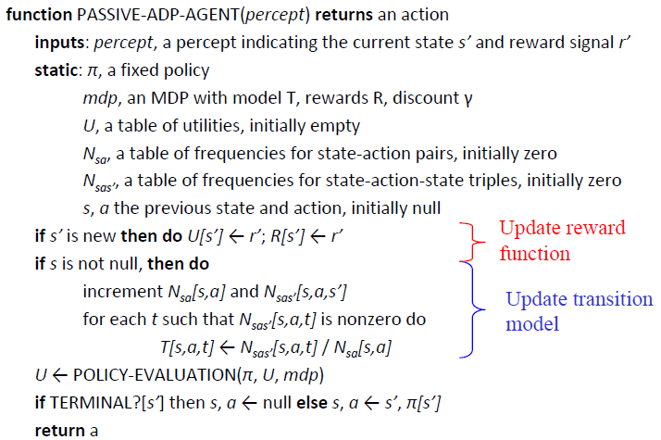
ADP Algorithm

Slide 27
The Problem with ADP
Need to solve a system of simultaneous equations – costs
Very hard to do if you have states like in Backgammon
Can we avoid the computational expense of full policy evaluation?

Slide 28
(model free)
Approach 3: Temporal Difference Learning
Instead of calculating the exact utility for a state can we approximate it and possibly make it less computationally expensive?
The idea behind Temporal Difference (TD) learning:
Instead of doing this sum over all successors, only adjust the utility of the state based on the successor observed in the trial.
(No need to estimate the transition model!)

Slide 29
TD Learning Example
Suppose you see that and after the first trial.
If the transition happens all the time, you would expect to see:
Since you observe in the first trial, it is a little lower than 0.88, so you might want to “bump” it towards 0.88.

Slide 30
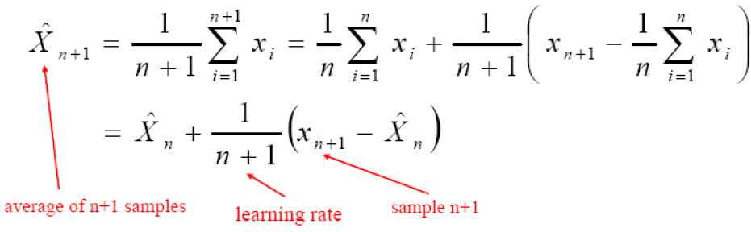
Aside: Online Mean Estimation
Suppose we want to incrementally compute the mean of a sequence of numbers
Given a new sample , the new mean is the old estimate (for n samples), plus the weighted difference between the new sample and the old estimate

Slide 31
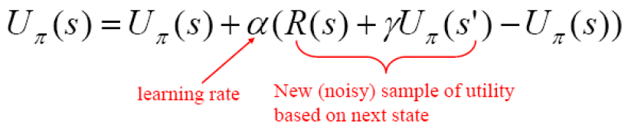
Temporal Difference Learning
TD update for transition from s to s’:
This equation calculates a “mean” of the (noisy) utility observations
If the learning rate decreases with the number of samples (e.g. ), then the utility estimates will eventually converge to their true values!

Slide 32
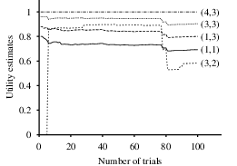
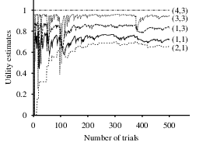
ADP and TD comparison
ADP
TD

Slide 33
ADP and TD comparison
Advantages of ADP:
Converges to the true utilities faster
Utility estimates don’t vary as much from the true utilities
Advantages of TD:
Simpler, less computation per observation
Crude but efficient first approximation to ADP
Don’t need to build a transition model in order to perform its updates (this is important because we can interleave computation with exploration rather than having to wait for the whole model to be built first)

Slide 34
Summary of Passive RL– What to remember:
How reinforcement learning differs from supervised learning and from MDPs
Pros and cons of:
Direct Utility Estimation
Adaptive Dynamic Programming
Temporal Difference Learning
Which methods are model free and which are model based.

Slide 35
Reinforcement Learning + Shaping in Action
TAMER by Brad Knox and Peter Stone
http://www.cs.utexas.edu/~bradknox/TAMER_in_Action.html

Slide 36
Autonomous Helicopter Flight
Combination of reinforcement learning with human demonstration, and several smart optimizations and tricks.
http://www.youtube.com/stanfordhelicopter

Slide 37
Active Reinforcement Learning Agents
We will talk about two types of Active Reinforcement Learning agents:
Active ADP
Q‐learning

Slide 38
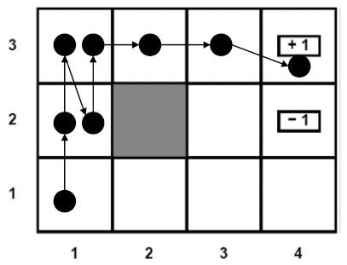
Goal of active learning
Let’s suppose we still have access to some sequence of trials performed by the agent
The goal is to learn an optimal policy

Slide 39
(model based)
Approach 1: Active ADP Agent
Using the data from its passive trials, the agent learns a transition model and a reward function
With and , it has an estimate of the underlying MDP
Compute the optimal policy by solving the Bellman equations using value iteration or policy iteration

Slide 40
Active ADP Agent
Now that we’ve got a policy that is optimal based on our current understanding of the world
Greedy agent: an agent that executes the optimal policy for the learned model at each time step

Slide 41
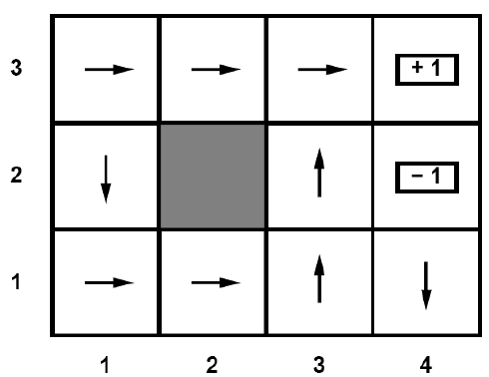
Problem with Greedily Exploiting the Current Policy
The agent finds the lower route to get to the goal state but never finds the optimal upper route. The agent is stubborn and doesn’t change so it doesn’t learn the true utilities or the true optimal policy

Slide 42
Why does choosing an optimal action lead to suboptimal results?
The learned model is not the same as the true environment
We need more training experience …

Slide 43
Exploitation vs Exploration
Actions are always taken for one of the two following purposes:
Exploitation: Execute the current optimal policy to get high payoff
Exploration: Try new sequences of (possibly random) actions to improve the agent’s knowledge of the environment even though current model doesn’t believe they have high payoff
Pure exploitation: gets stuck in a rut
Pure exploration: not much use if you don’t put that knowledge

Slide 44
Optimal Exploration Strategy?
What is the optimal exploration strategy?
Greedy?
Random?
Mixed? (Sometimes use greedy sometimes use random)

Slide 45
ε‐greedy exploration
Choose optimal action with probability
Choose a random action with probability
Chance of any single action being selected:
Decrease over time

Slide 46
Active ε‐greedy ADP agent
1. Start with initial T and R learned from the original sequence of trials
2. Compute the utilities of states using value iteration
3. Take action use the ε‐greedy exploitation‐exploration strategy
4. Update and , go to 2

Slide 47
Another approach
Favor actions the agent has not tried very often, avoid actions believed to be of low utility
Achieved by altering value iteration to use , which is an optimistic estimate of the utility of the state s (using an exploration function)

Slide 48
Exploration Function
Originally:
With exploration function:
= number of times action tried in state
= optimistic estimate of the utility of state
= exploration function

Slide 49

Exploration Function
Number of times has been tried.
The usual utility value.
is a limit on the number of tries for a state-action pair
is an optimistic estimate of the best possible reward obtainable in any state
If hasn’t been tried enough in , you assume it will somehow lead to high reward– optimistic strategy
Trades off greedy (preference for high utilities ) against curiosity (preference for low values of n – the number of times a state-action pair has been tried)

Slide 50
Using Exploration Functions
Start with initial and learned from the original sequence of trials
Perform value iteration to compute using the exploration function
Take the greedy action
Update estimated model and go to 2

Slide 51
Questions on Active ADP?

Slide 52
(model free)
Approach 2: Q‐learning
Previously, we needed to store utility values for a state
ie. = utility of state
Equal to: expected sum of future rewards
Now, we will store Q‐values, which are defined as:
= value of taking action at state
Equal to: expected maximum sum of future discounted rewards

Slide 53

Q‐learning
For each state
Instead of storing a table with
Store table with
Relationship between the models:

Slide 54
Example
Example of how we can get the utility U(s) from the Q-table:
5
The utility represents the “goodness” of the best action

Slide 55
What is the benefit of calculating ?
If you estimate Q(a,s) for all and , you can simply choose the action that maximize , without needing to derive a model of the environment and solve an MDP.

Slide 56
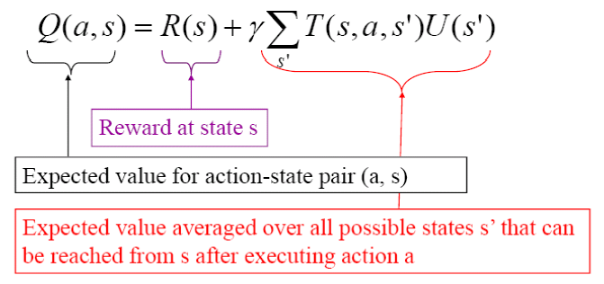
Q‐learning

Slide 57
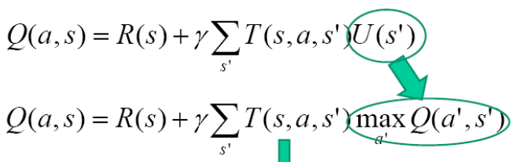
Q‐learning
Notes:
<number>

Slide 58
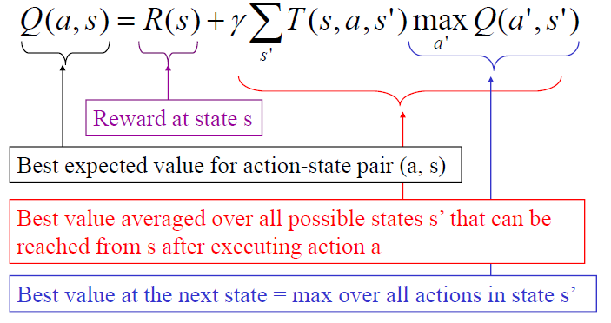
Q‐learning

Slide 59
Q‐learning
But this still requires a transition function. Can we do this calculation in a model-free way?

Slide 60
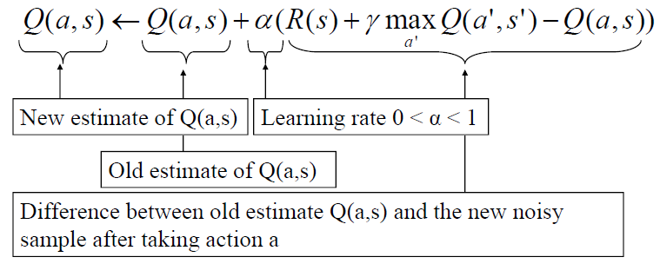
Q‐learning without a model
We can use a temporal differencing approach which is model‐free
Q-Update: after moving from state to state using action :

Slide 61

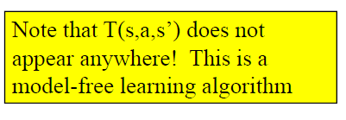
Q‐learning Summary
Q-Update: after moving from state to state using action :
Policy estimation:

Slide 62
Q‐learning Convergence
Guaranteed to converge to an optimal policy
Very general procedure, widely used
Converges slower than ADP agent
completely model free and does not enforce consistency among values through the model

Slide 63
What You Should Know
Direct Utility Estimation
ADP (passive, active)
TD-learning (passive, Q-Learning)
Exploration vs exploitation
Exploration schemes
Difference between model‐free and model-based methods

Slide 64
Summary of Methods
DUE: Directly estimate the utility of the states Uπ(s) by averaging “reward‐to‐go” from each state – slow convergence, not using the Bellman equation constraints
ADP: learn the transition model T and the reward function R, then do policy evaluation to learn Uπ(s) – few updates, but each update is expensive ()
TD learning: maintain a running average of the state utilities by doing online mean estimation – cheap updates but needs more updates than ADP

